Slide 1
INTRODUCTION TO Reinforcement Learning
Harshit jaiswal 9916103218
Mayank 9916103156

Slide 2
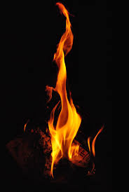
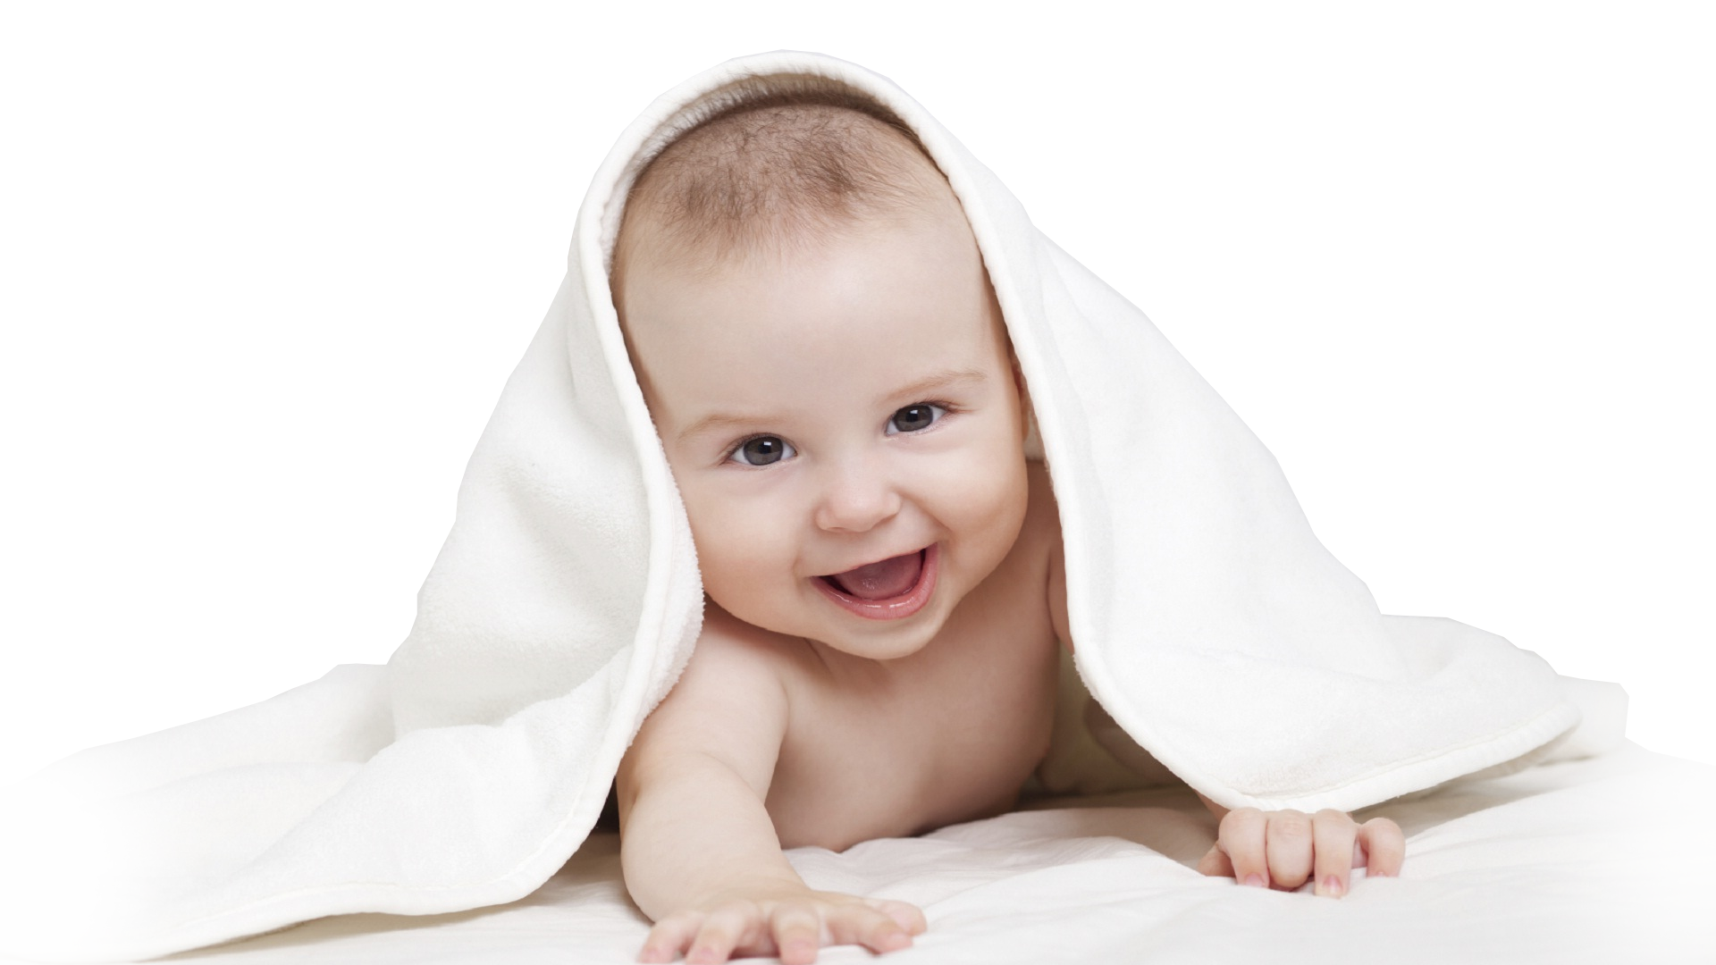
Baby learns from trial and error:
Baby comes near to fire, feel warm and positive. FIRE is a positive thing.

Slide 3
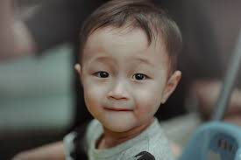
Baby touches the fire and got his hand burn. Finally he understand that FIRE is a positive thing when
felt from distance but could be dangerous when touched.
“LEARNING FROM INTERACTION FROM ENVIRONMENT COMES FROM OUR NATURAL EXPERIENCE.”

Slide 4
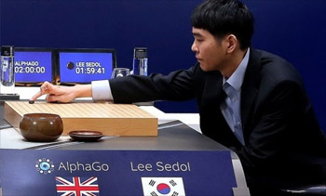
Reinforcement learning :
“It is a mathematical formulation where an agent will learn from the environment by interacting with it and receiving rewards for performing actions.”
HISTORY :
BEATING THE WORLD CHAMPION LEE SEDOL : 2016 - ALPHA GO

Slide 5
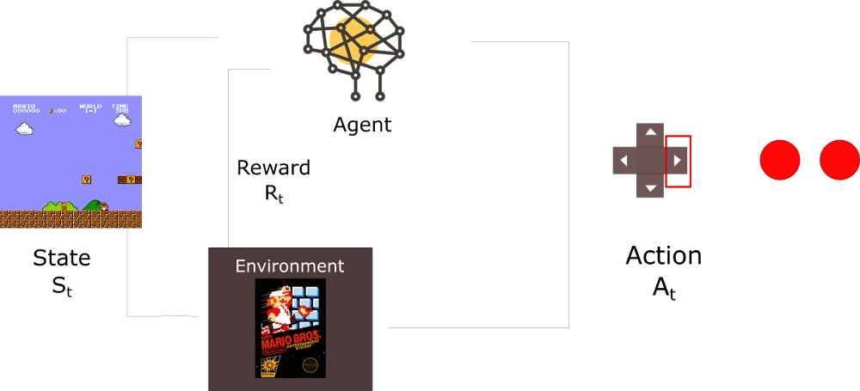
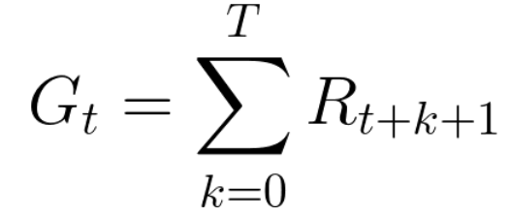
REWARD HYPOTHESIS:
REWARD FUNCTION:
THE CENTRAL IDEA OF REWARD HYPOTHESIS
IS TO MAXIMIZE THE EXPECTED CUMULATIVE REWARD

Slide 6
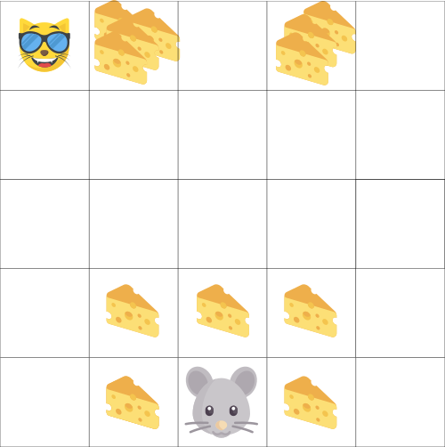
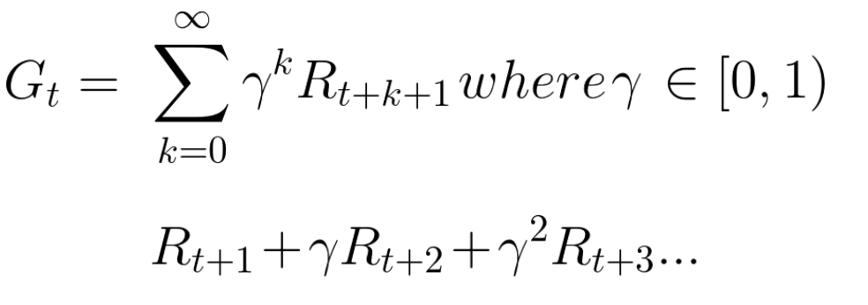
NEW THEORY: ROLE OF GAMMA(discount rate)
FEATURES OF GAMMA:
The larger the gamma, the smaller the discount. This means
the learning agent cares more about the long term reward.
On the other hand, the smaller the gamma, the bigger the
discount. This means our agent cares more about the short
term reward (the nearest cheese).
DISCOUNTED CUMMULATIVE REWARD FUNCTION:

Slide 7
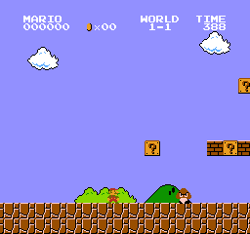
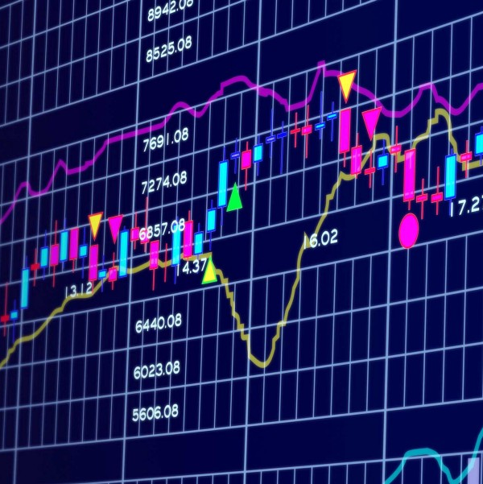
EPISODIC AND CONTINNOUS TASKS:
An episode begin t the launch of
a new Mario and ending: when you
are killed you reach the end of the
Level.
Here there is no ending state. It
Keep running until we decide to stop
Him.

Slide 8
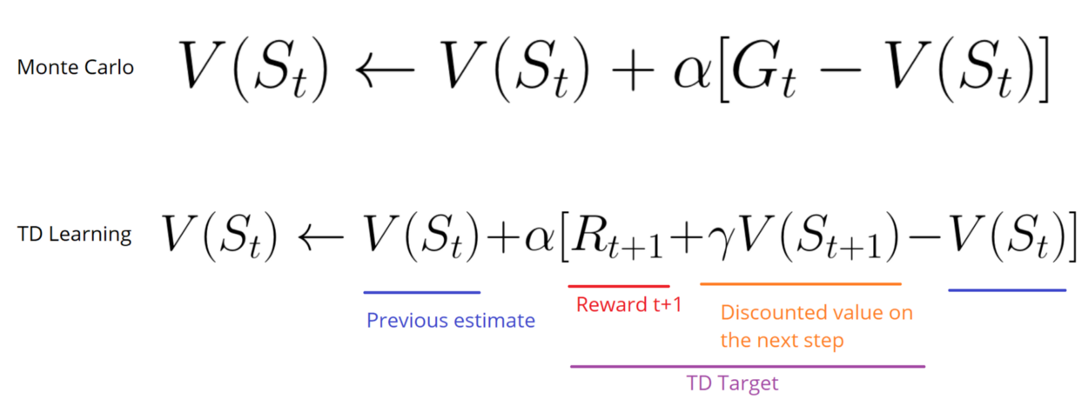
Ways of learning:
MONTE CARLO APPROACH:
TEMPORAL LEARNING DIFFERENCE:
α
LEARNING RATE

Slide 9
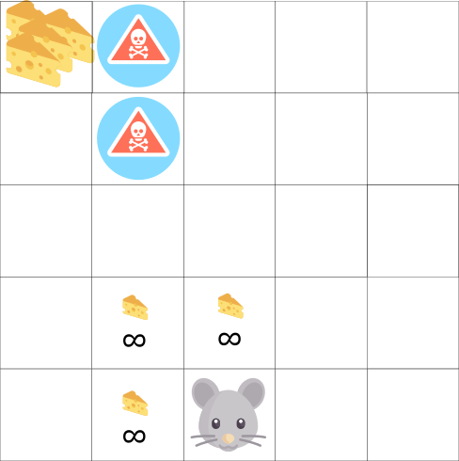
Exploration/Exploitation trade off:
Exploration is finding more
information about the
environment.
Exploitation is exploiting
known information to
maximize the reward.

Slide 10
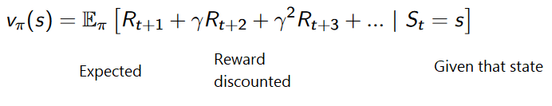
APPROACHES TO REINFORCEMENT LEARNING:
VALUE BASED APPROACH:
“The value function is a function that tells us the maximum expected future reward the agent
will get at each state.”

Slide 11
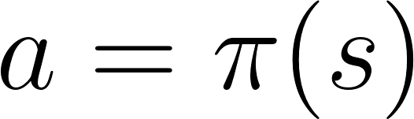
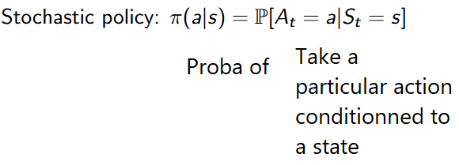
Policy based:

Slide 12
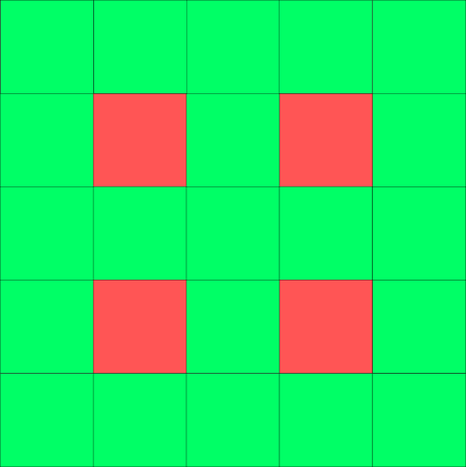

INTRODUCTION TO q-LEARNING:

Slide 13
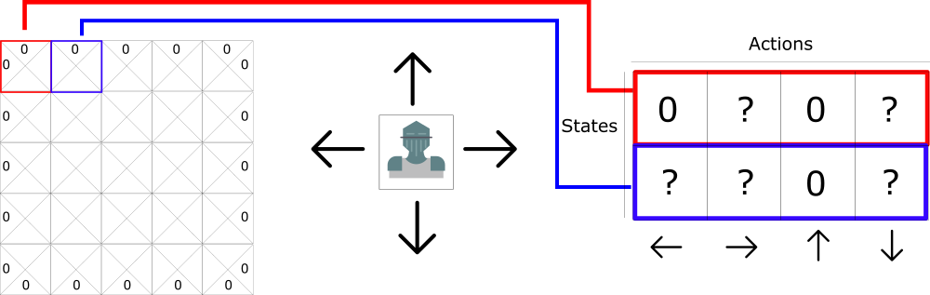
INTRODUCTION TO Q-TABLE:

Slide 14
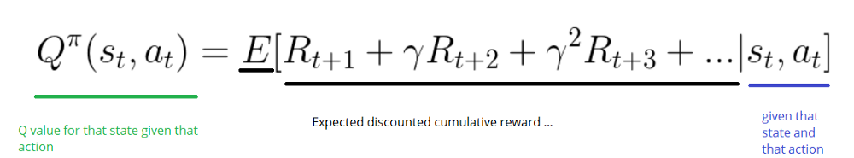
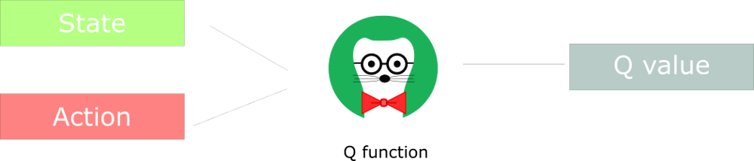
Q- Learning algorithm:

Slide 15
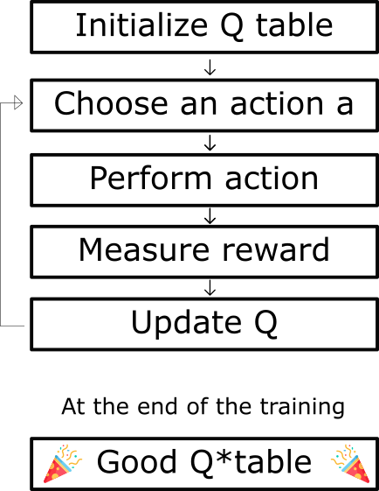
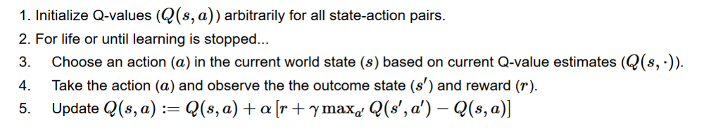
THE Q-LEARNING ALGORITHM:

Slide 16
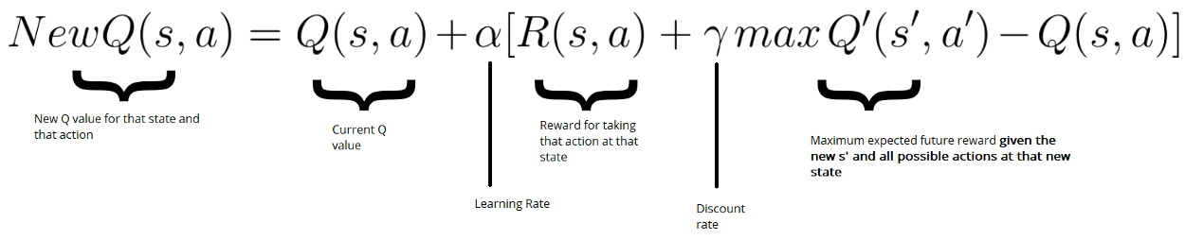
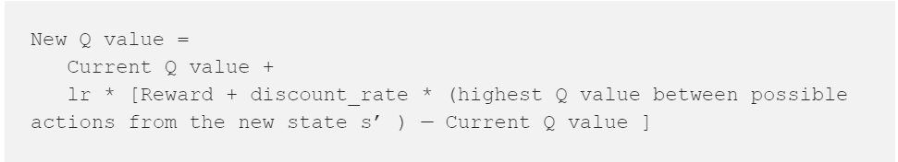
BELLMAN EQUATION:

Slide 17
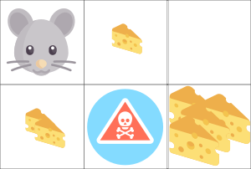
Example:

Slide 18
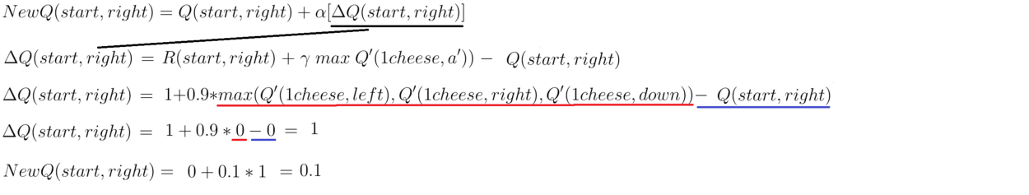
UPDATED Q-FUNCTION:

Slide 19
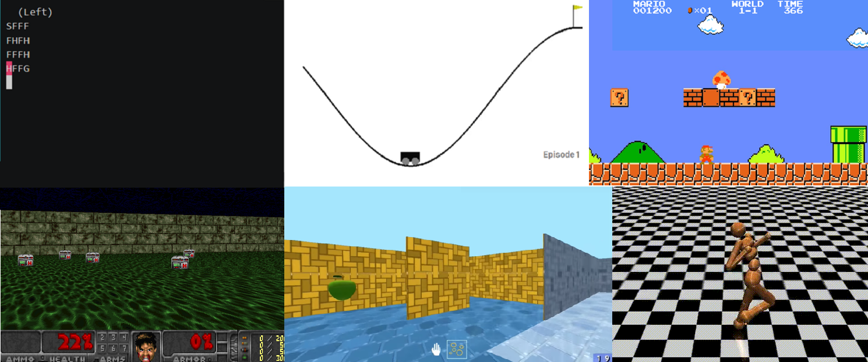
THANK YOU!!!

